Slide 1
UT Robomasters – Supercap System
Egan Wang (ew23776)
Presented 2/10/2026

Slide 2
Power OR-ing
Objectives:
Draw excess power from battery in low-load periods
Provide supplementary power to robot during high-load periods
Avoid exceeding 90W power budget
90W
Power
Time

Slide 3
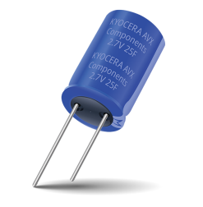
Supercaps
Objectives:
Draw excess power from battery in low-load periods
Provide supplementary power to robot during high-load periods
Avoid exceeding 90W power budget
x4
598-DSF117Q3R0
0-3V
110F

Slide 4
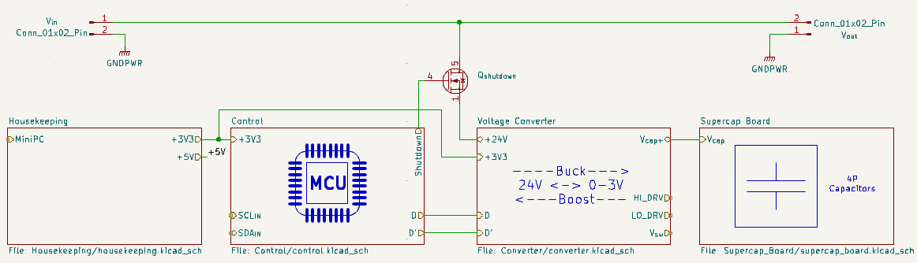
General Design & Problem Statement
Can directly control: duty cycle
Want to control: current coming from battery, set constant
Inputs: voltages, currents
Problem Statement

Slide 5
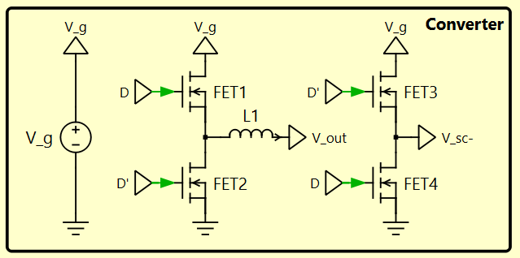
Converter Design – “Full-bridge Buck Converter”
Voltage gain of 2D-1 when operated as shown in diagram
Avoids extreme duty cycles for conversion from 22-26V to 0-3V
Should be bidirectional

Slide 6
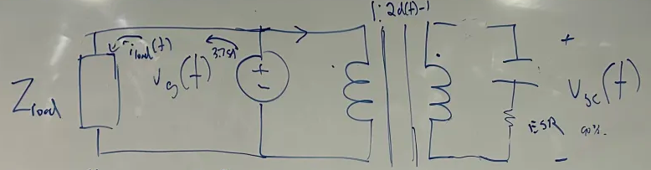
Controls Design
Assumes converter to be ideal transformer
Closed-loop system to set battery current equal to reference calculated using 90W power budget and battery voltage measurement
Specific design of compensator still under development

Slide 7
Kalman Filtering – Current Sensing
Create linearized model of circuit to calculate supercap voltage and input current
Reduce noise of input measurements
Requires profiling to determine if useful

